Slide 1
Konan Kouame
Course Portfolio: My CIS-151 Journey goo.gl/2VBwCe

Slide 2
Table of Contents
Analysis (Discovery)
Pre-Consult Form
Pre Consult Merge Doc [with Notes]
Scoping Doc
[Contract]
Design
User-Based Design Series
Site Map
Wireframe
Development
Wordpress Home Page Screenshot, Default Theme
Wordpress Home Page Screenshot, New Theme
Evaluation
What do I think of my site?
What did I learn in this course?
What do I want to tell Professor M?

Slide 3
Scoping Doc
https://docs.google.com/document/d/1rN2FjBTnPnGFlQ7Bzsn7nvUKcY-3bwBbTnXnmN_Mbuc/edit

Slide 4
Site Map
https://docs.google.com/document/d/1NUmTtXttZx4aIYFf3c6aFXR64pfkraQQqHIXEdTQFZY/edit

Slide 5
Wireframe Diagram
https://docs.google.com/document/d/1FCZZS46UiqSJX0Wjpoa5QR0uS5UPrGlbdkoYwrueEos/edit

Slide 6
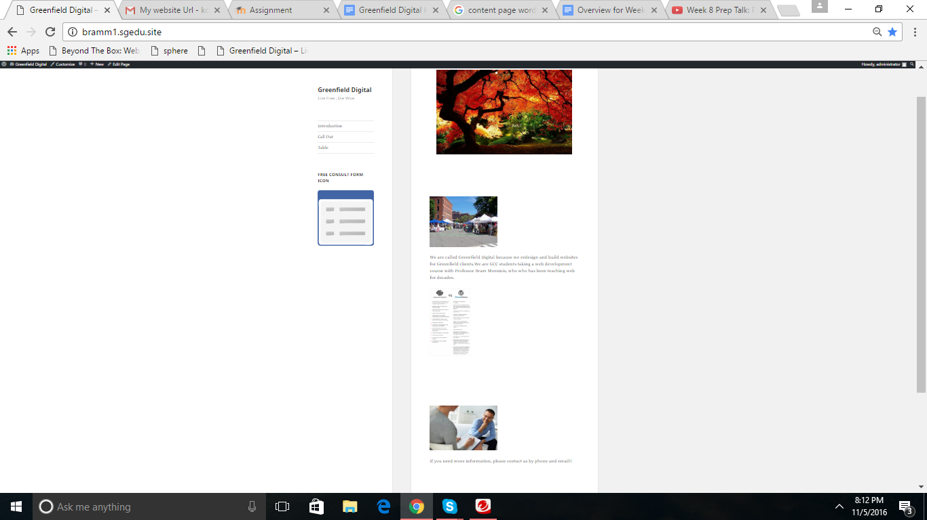
Wordpress Home Page Screenshot, Default Theme

Slide 7
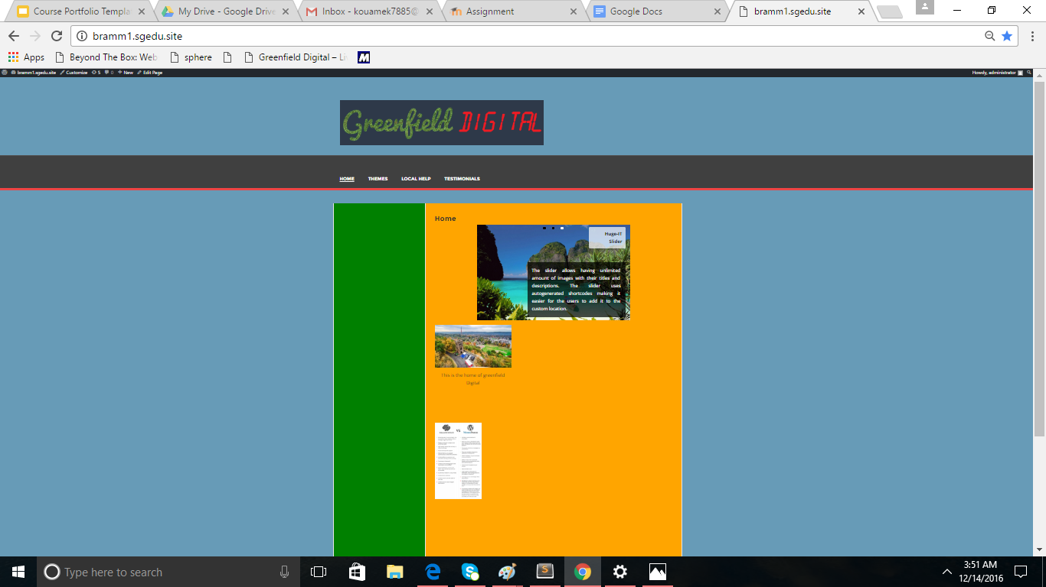
Wordpress Home Page Screenshot, New Theme

Slide 8
Evaluation
What do I think of my site?
What did I learn in this course?

Slide 9
My work
http://bramm1.sgedu.site/galleries/themes/

Slide 10
What do I think of my site?
A before and after comparison: what the HTML site looked like, what it looks like and does now.

Slide 11
What did I learn in this course?
Process Skills: Describe your Discovery Process with samples (pre-consult form, merge doc, scope of work)
Technical skills: describe connections between site map, wireframe, conversion path, HTML/CSS, Wordpress.

